Slide 1
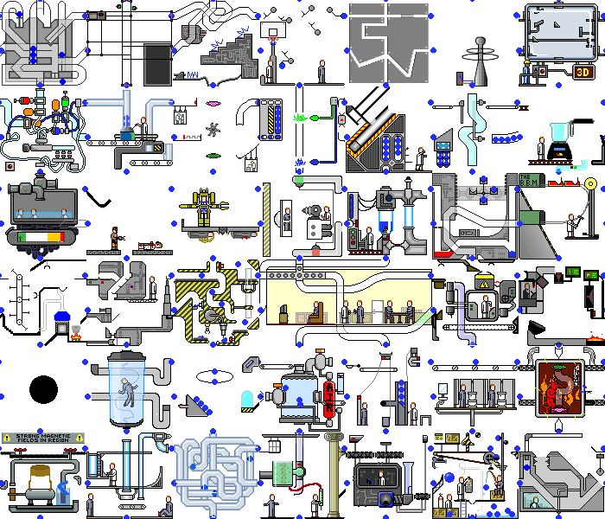
GPars:
Unsung Hero of Concurrency in Practice
http://playstationna.i.lithium.com/t5/image/serverpage/image-id/432281iDADEAFC04868CE5C?v=1.0

Slide 2
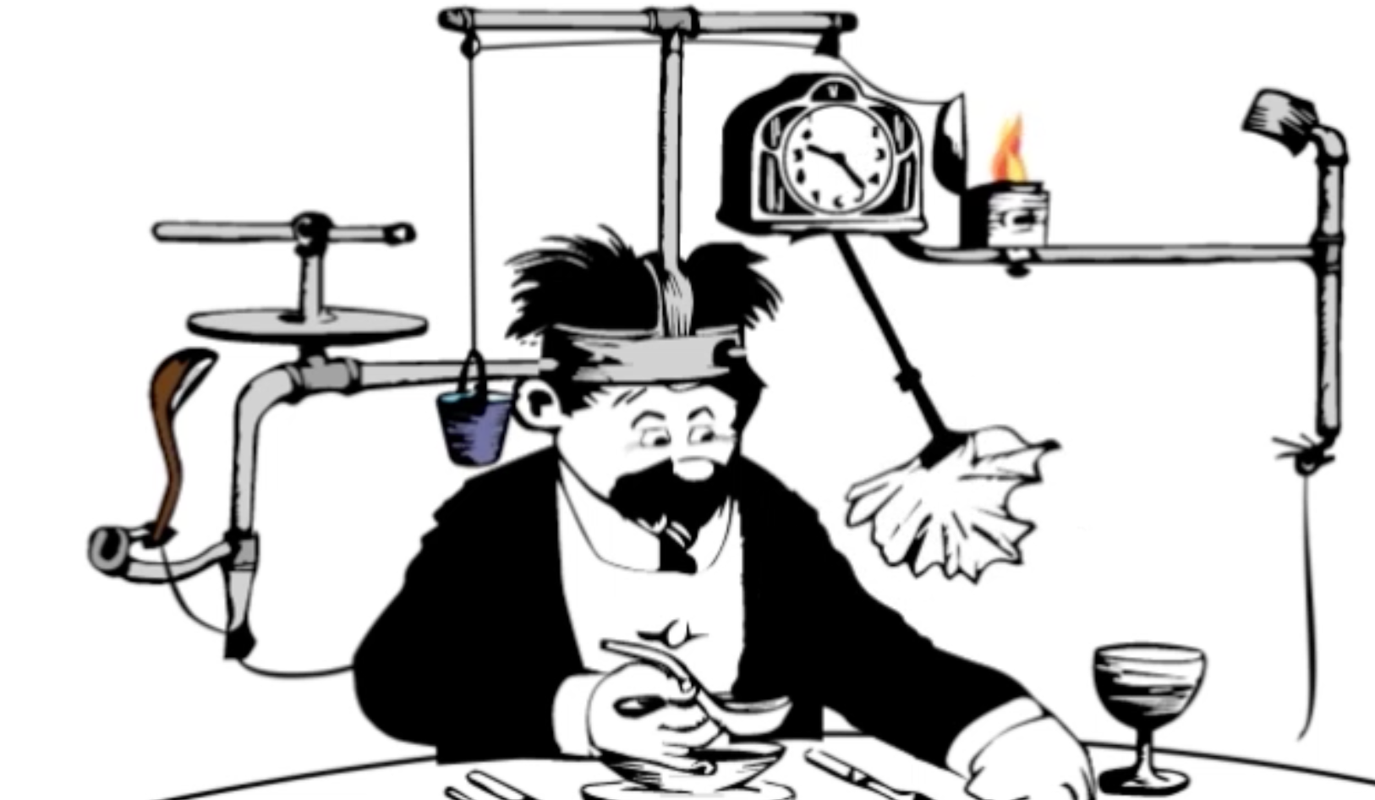
Yaroslav Yermilov Senior Software Engineer EPAM Systems https://yermilov.github.io/ https://twitter.com/yermilov17 https://www.facebook.com/yaroslav.yermilov https://ua.linkedin.com/pub/yaroslav-yermilov/58/682/506
work for EPAM Systems since 2011 in office - clustering, Big Data and automated testing out of office - Groovy
https://motherboard.vice.com/en_us/article/inside-rube-goldberg-machine-youtube-video-artist-joseph-herschers-bedroom-workshop

Slide 3
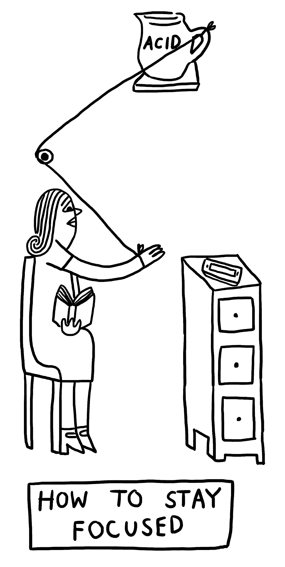
Focus for this talk
obey Moore’s law
how Java handles concurrent/parallel development?
GPars place in this picture
how GPars handles concurrent/parallel development?
why and when use GPars?
why and when do not use GPars?
http://www.theverge.com/2015/4/22/8381963/rube-goldberg-machine-contest-history-ideas

Slide 4
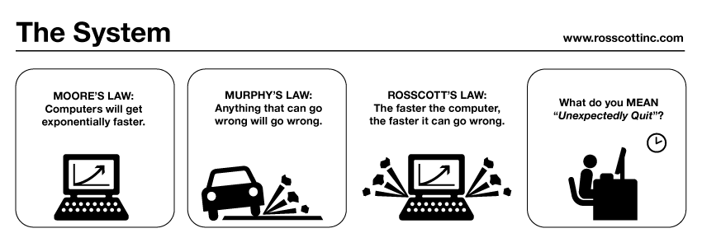
http://www.systemcomic.com/2009/04/27/the-system-197

Slide 5
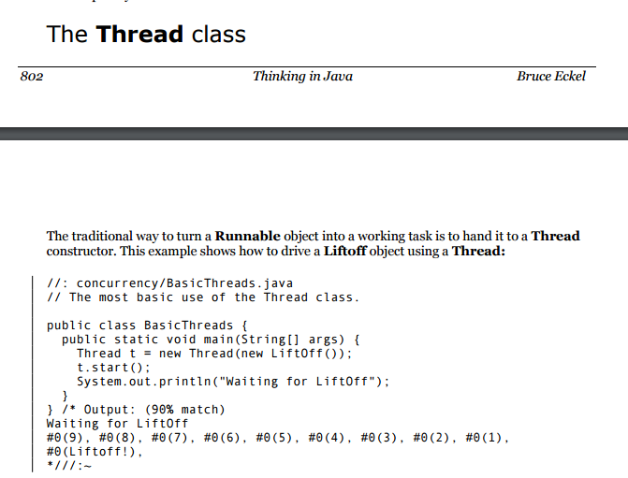

Slide 6
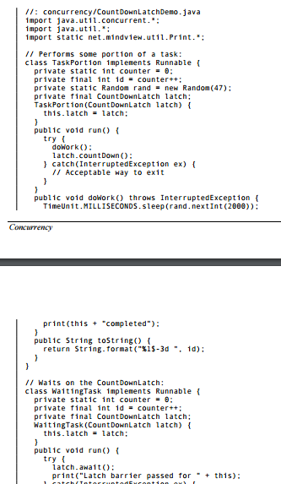
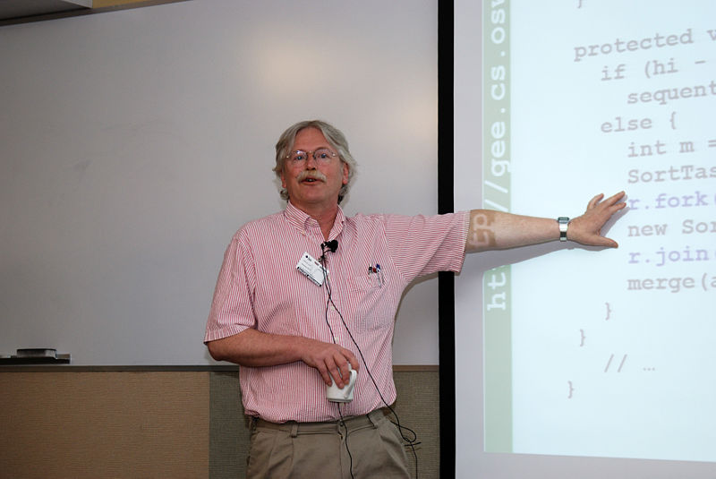
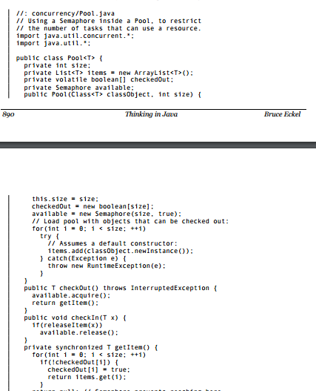
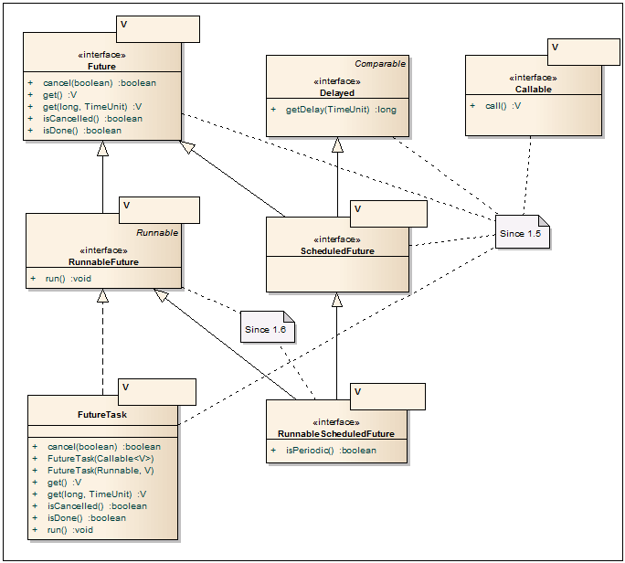
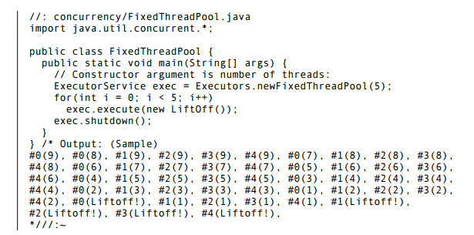
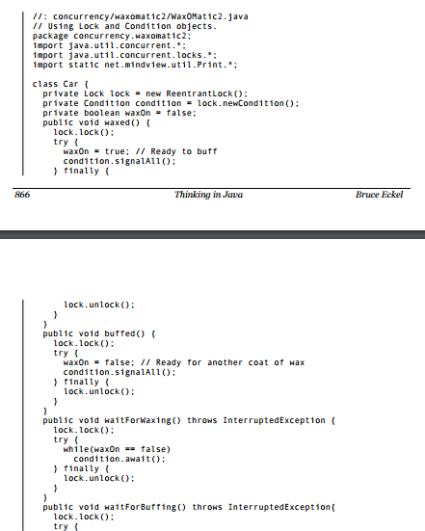
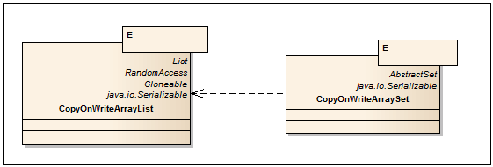
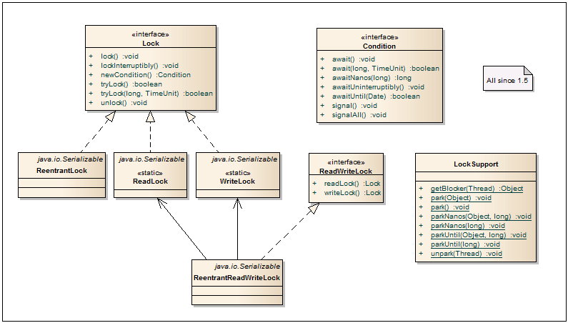
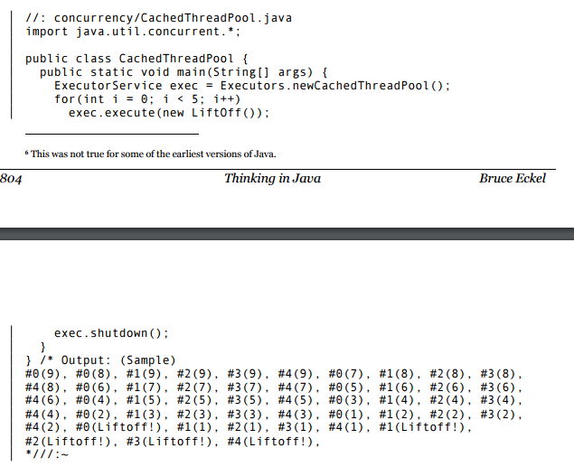
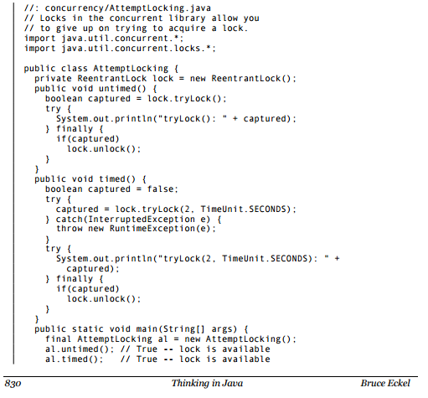
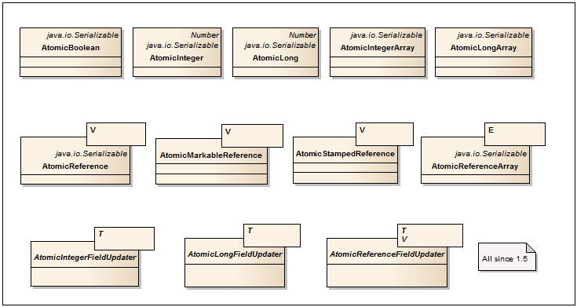
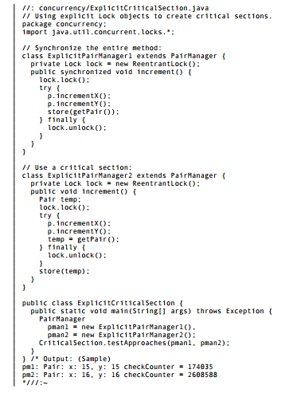
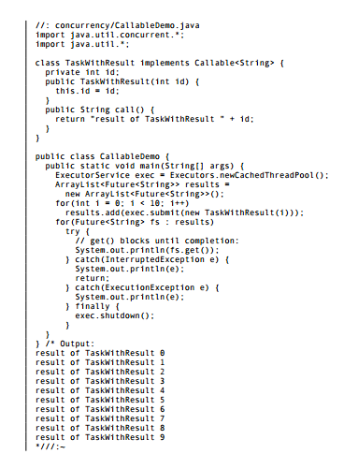
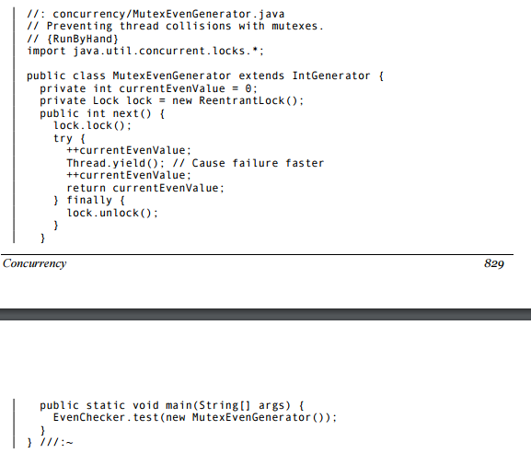
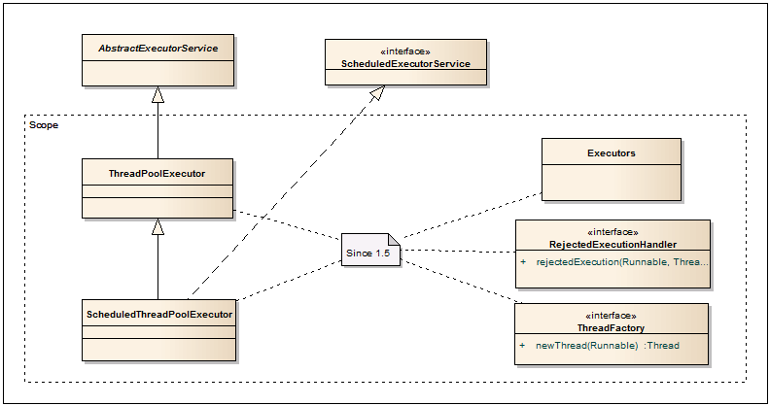
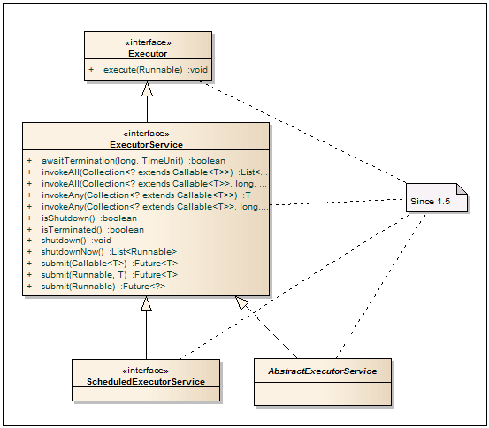
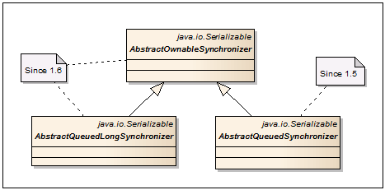
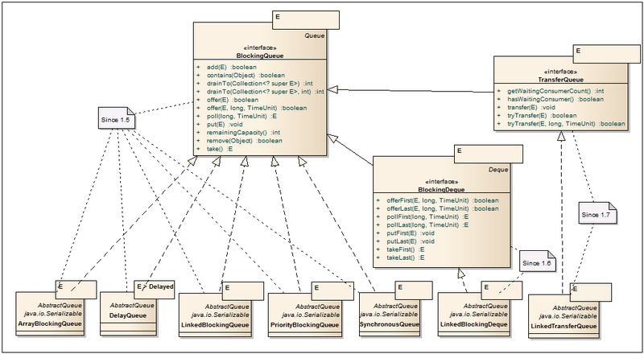
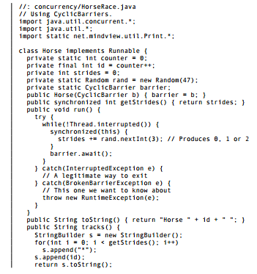
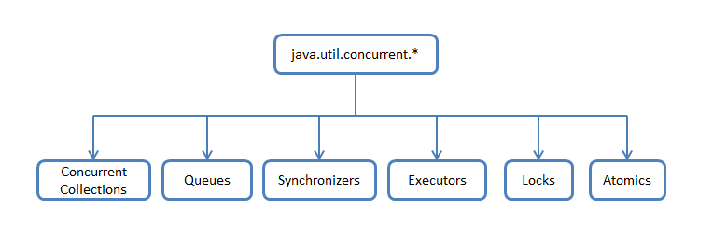
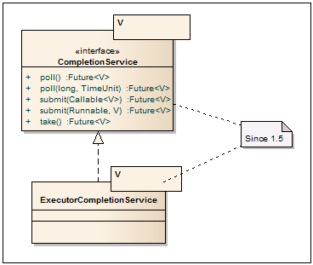
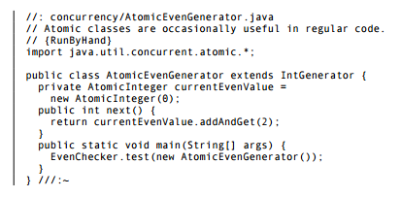
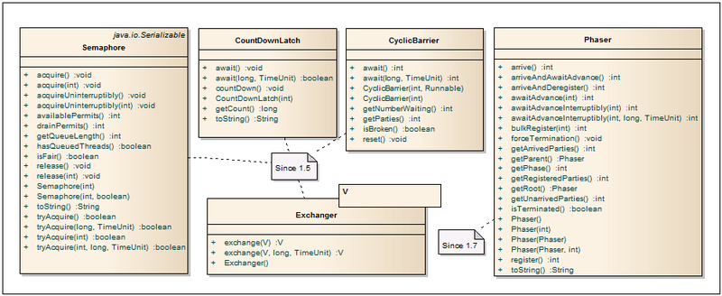
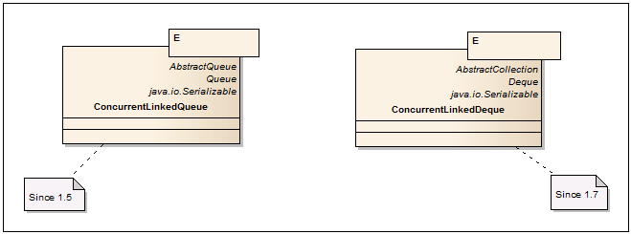
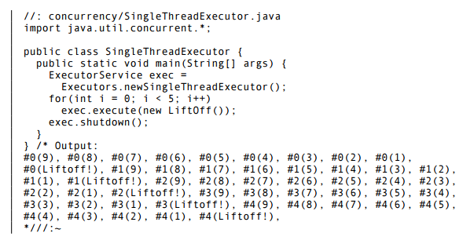
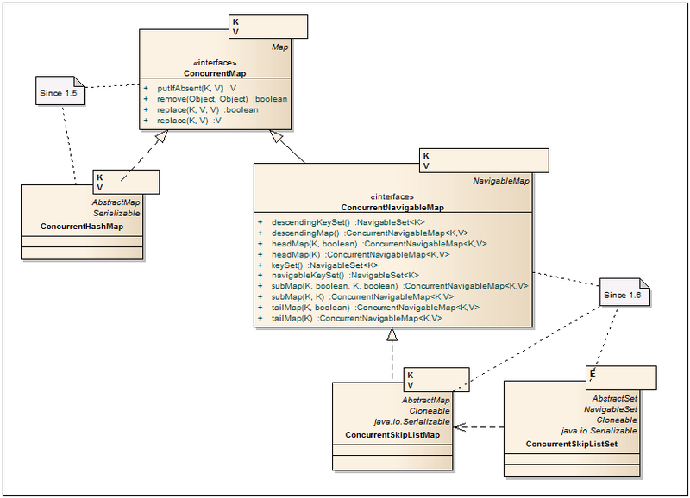
https://habrahabr.ru/company/luxoft/blog/157273/

Slide 7
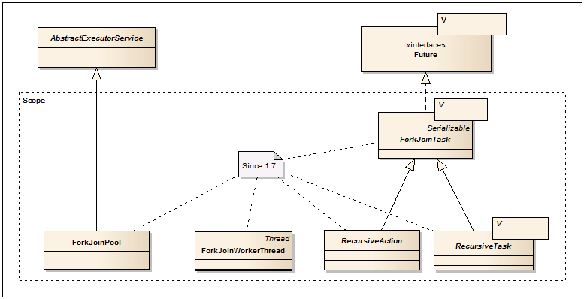

Slide 8
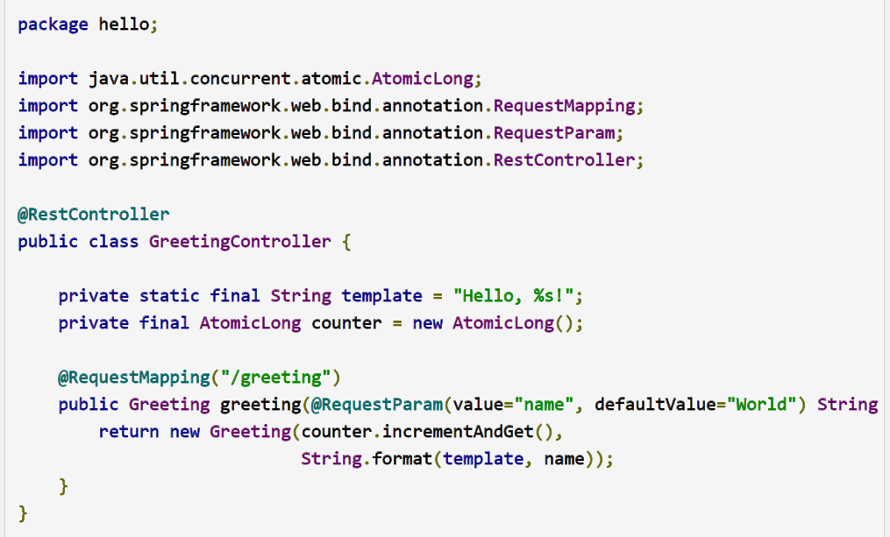
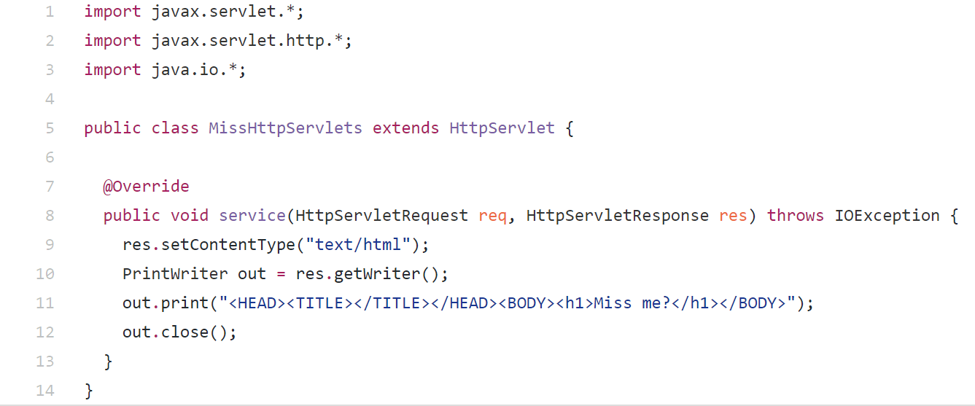

Slide 9
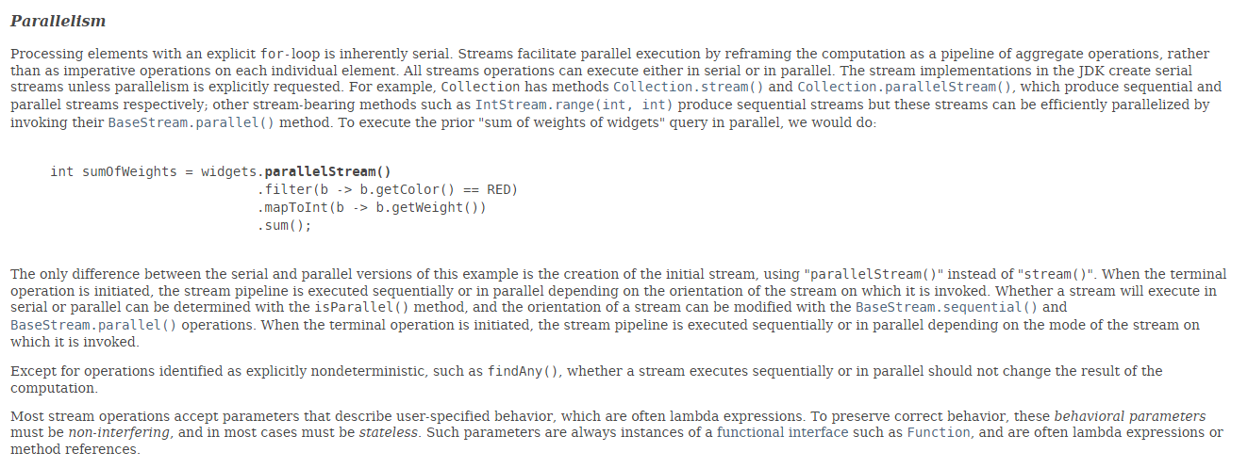

Slide 10
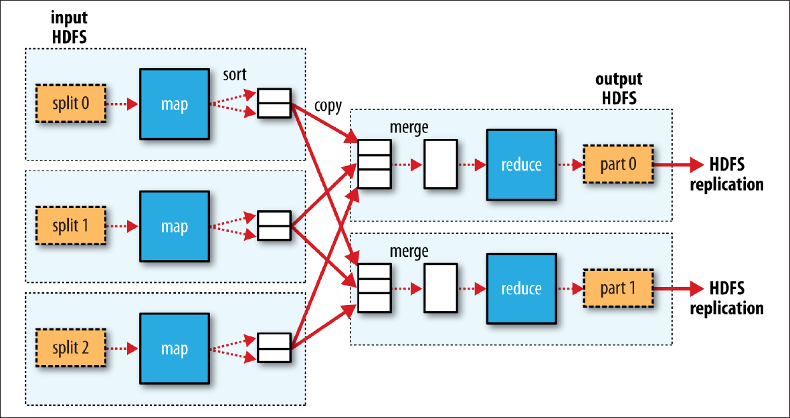

Slide 11
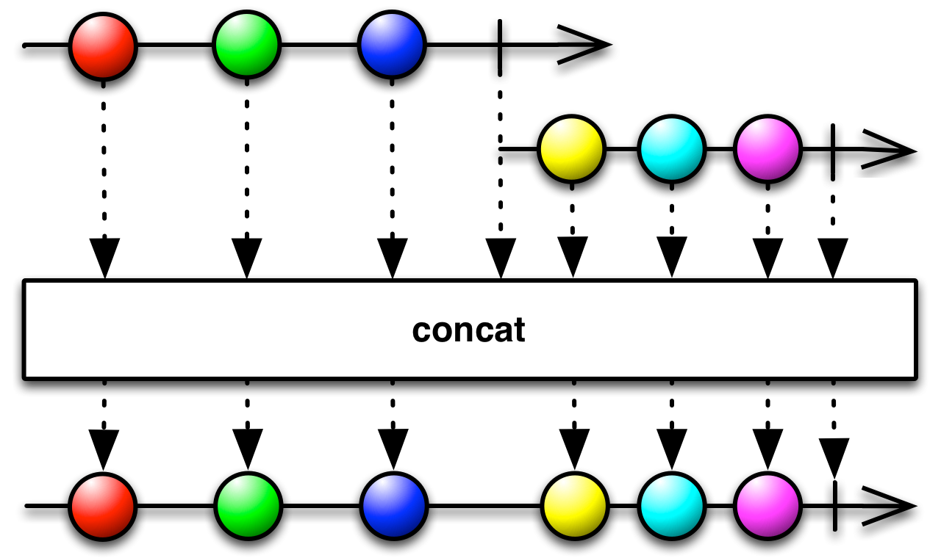
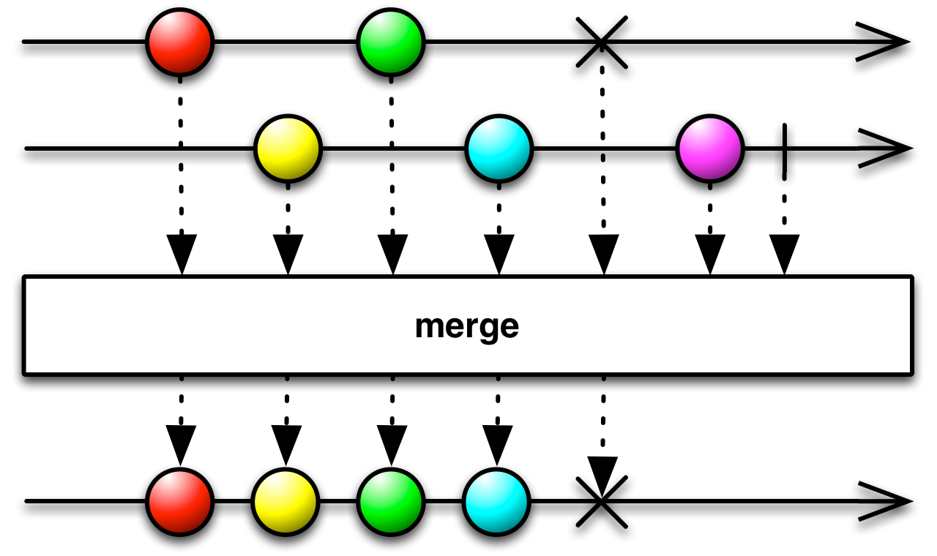
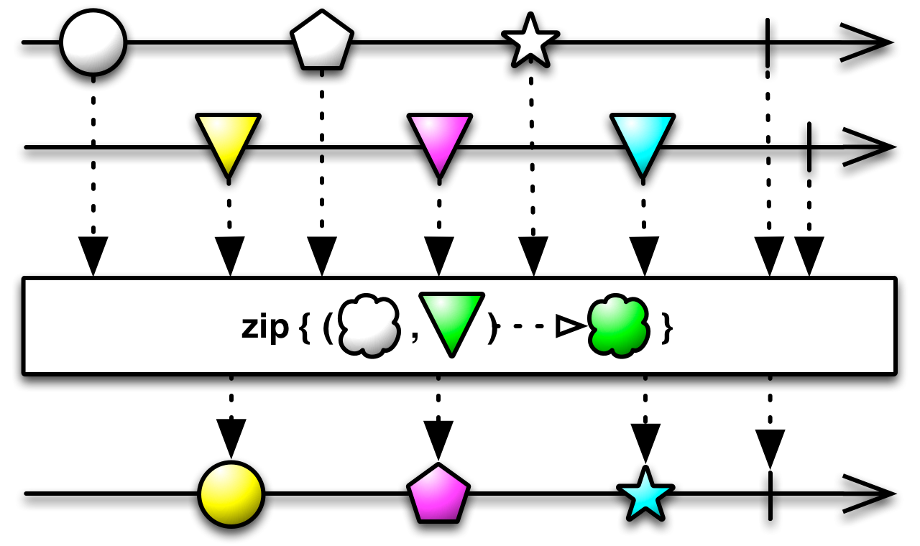
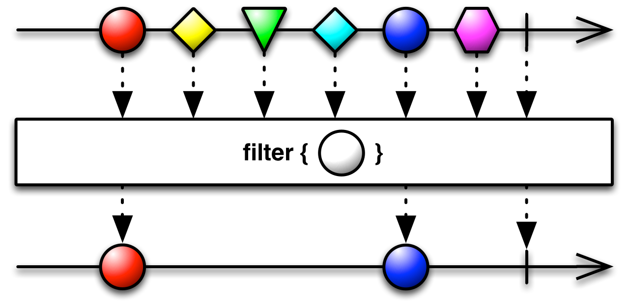
http://reactivex.io/RxJava/2.x/javadoc/io/reactivex/Flowable.html

Slide 12


Slide 13
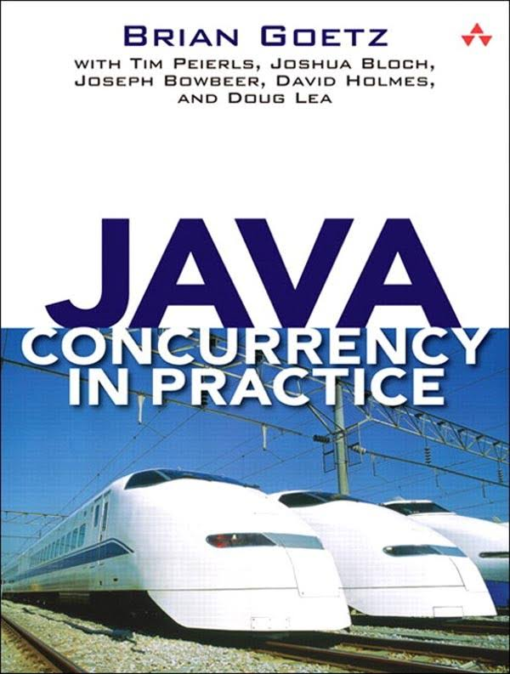
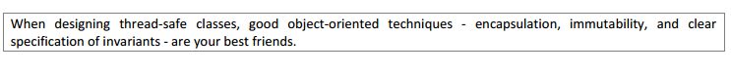
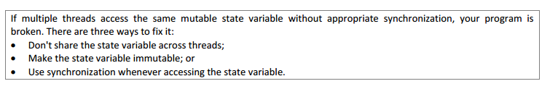

Slide 14
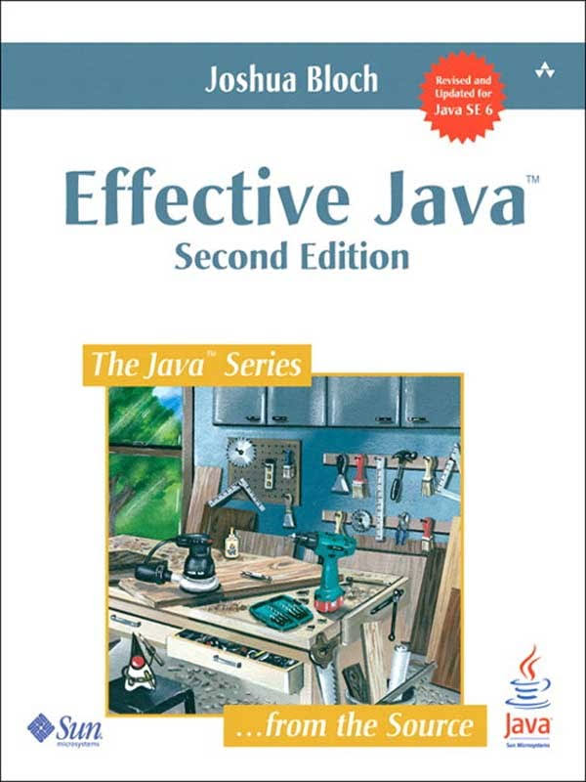
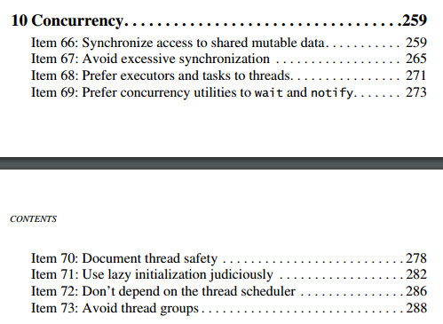

Slide 15
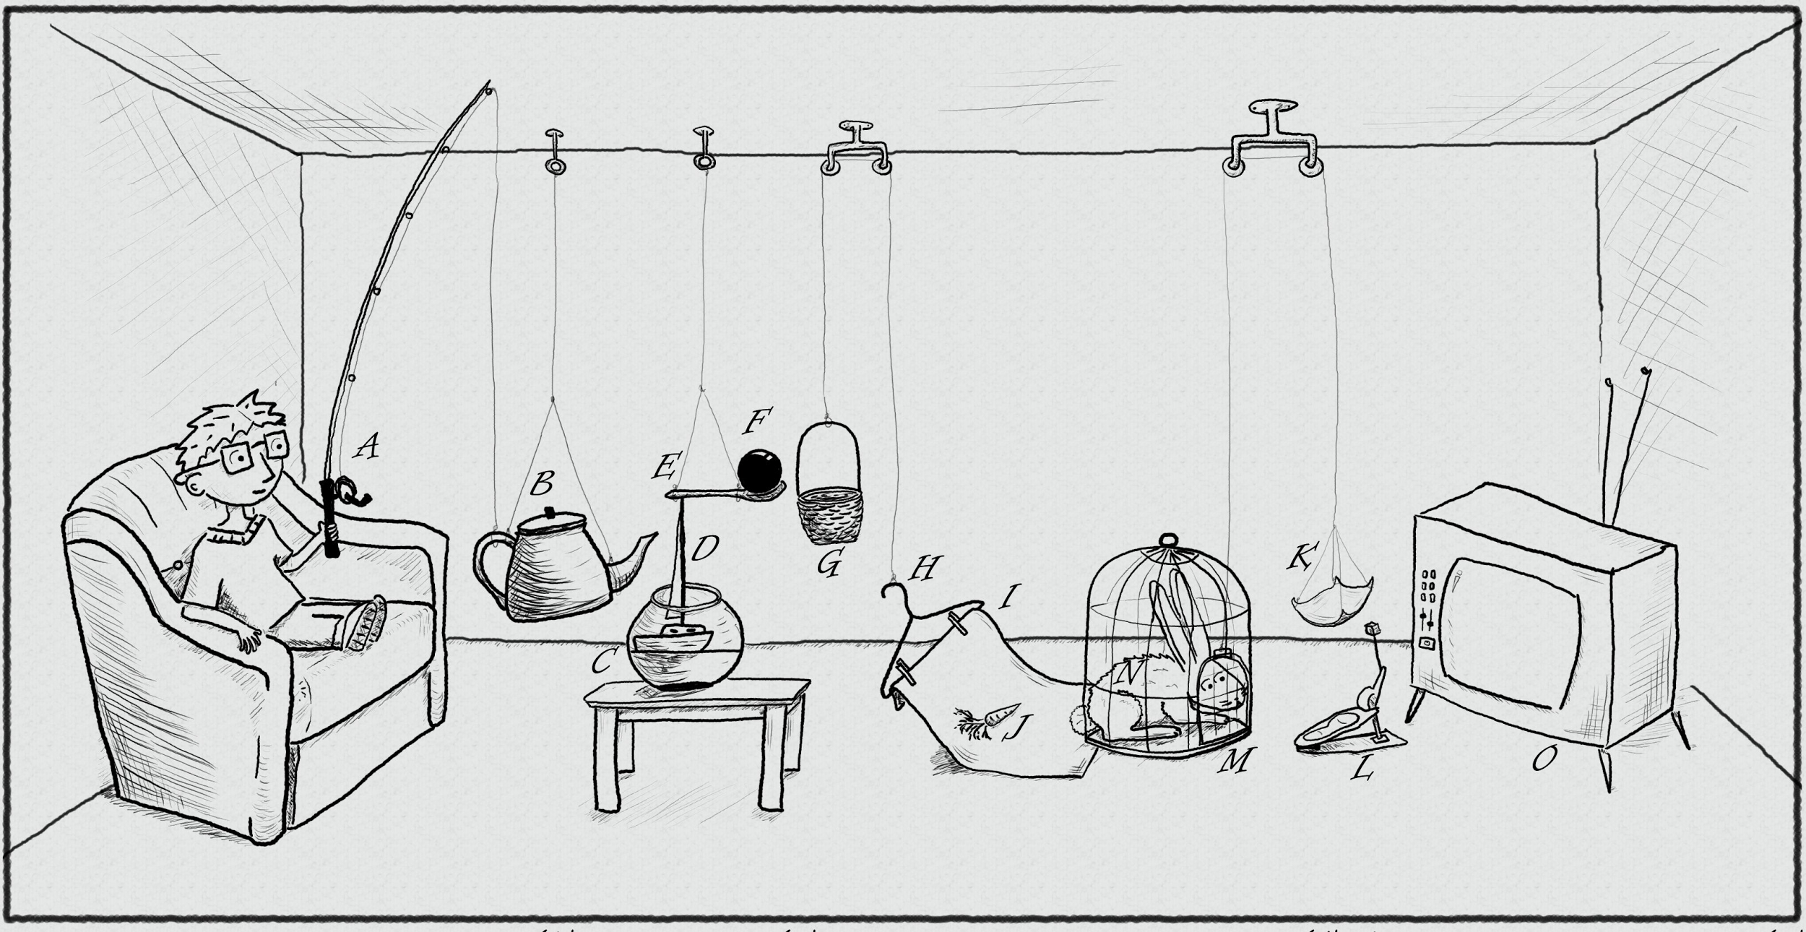
The traditional thread-based concurrency model built into Java doesn’t match well with the natural human sense for parallelism. While this was not a problem at times, when the level of parallelism in software was low and concurrency offered only limited benefits compared to sequential code.
Nowadays, with the number of cores on a single main-stream chip doubling almost every year, sequential code quickly looses ground and fails to compete in performance and hardware utilization with concurrent code.
https://www.pinterest.com/pin/395190936024778319/

Slide 16
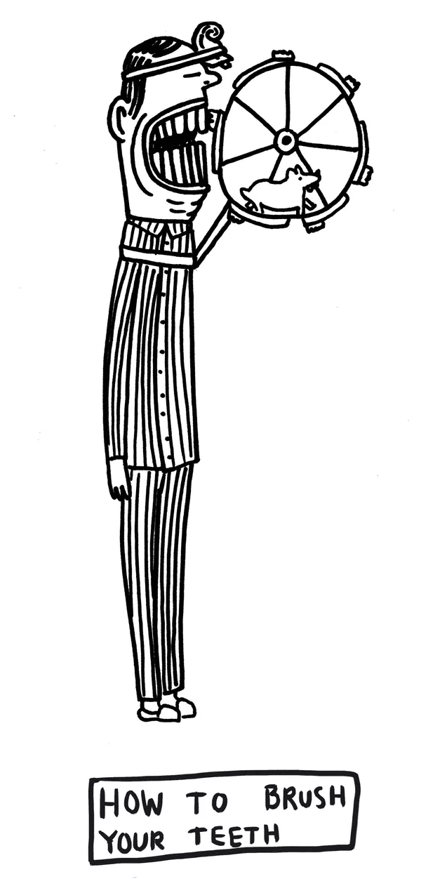
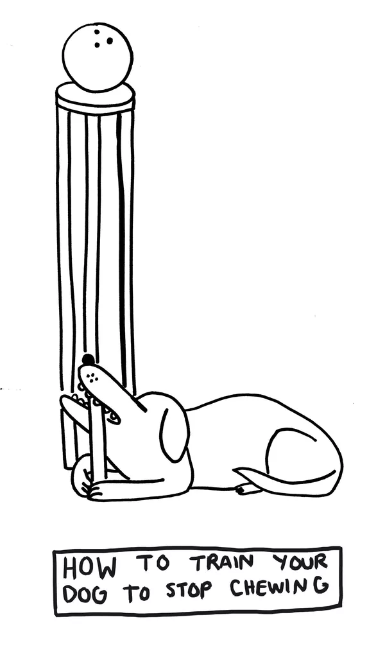
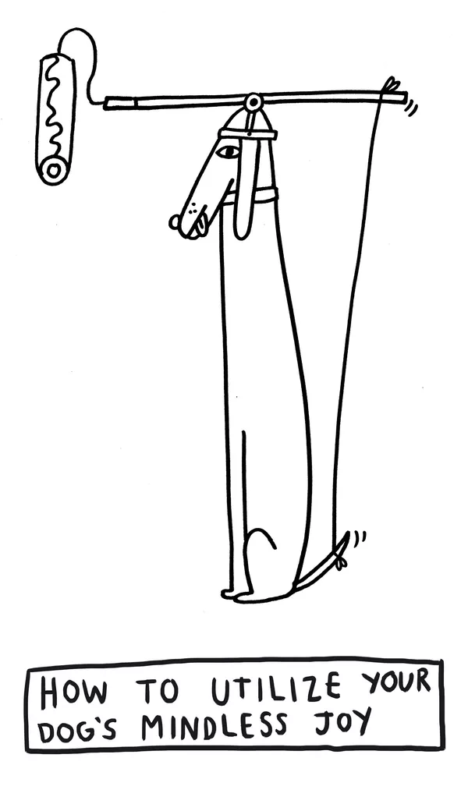
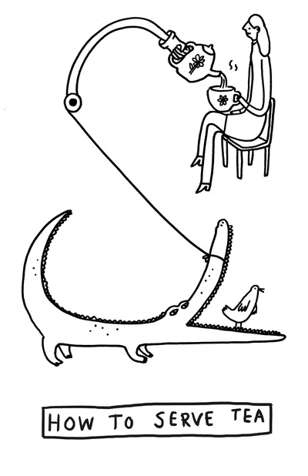

Meet GPars, an open-source concurrency and parallelism library for Java and Groovy that gives you a number of high-level abstractions to write concurrent and parallel code in Groovy (map/reduce, fork/join, asynchronous closures, actors, agents, dataflow concurrency and other concepts), which can make your Java and Groovy code concurrent and/or parallel with little effort.
http://www.theverge.com/2015/4/22/8381963/rube-goldberg-machine-contest-history-ideas

Slide 17

DEMO
https://www.pinterest.com/pin/527554543837493577/

Slide 18



Slide 19
why and when use GPars?

Slide 20
why and when do not use GPars?

Slide 21
Further dive

